Slide 1




Slide 2
About Startek
Welcome to Startek, we’re delighted that you have chosen to join our team!
As a Startek associate, you are one of a 38,000 strong community located in 12 countries around the world, and 20,000 employees in India. Together, we’re on a mission to deliver customer experience excellence for leading brands.
Vision
Bringing brands across the globe closer to their customers through memorable, personalized experiences.
Mission
To effectively combine people, technology and data to deliver customer experience excellence for leading brands, creating value for our customers, opportunity for our people and profitable growth for our shareholders.

Slide 3
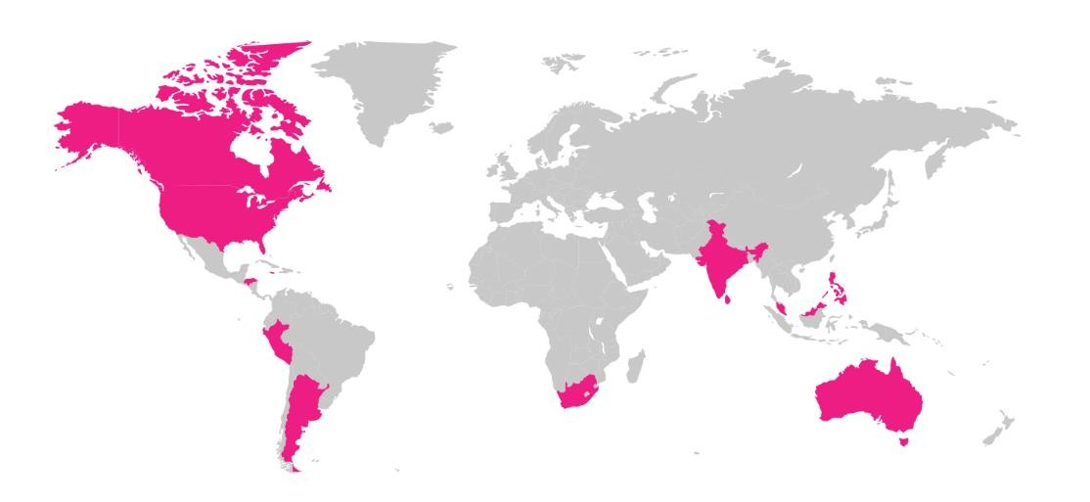

Locations in India & Global
U.S.
Mansfield, OH
Myrtle Beach, SC Denver, CO (HQ)
Argentina Córdoba Tucumán
Australia
Melbourne, Victoria
India Bangalore (3) Bhopal Chhindwara Gurgaon Hyderabad Kolkata (2) Lucknow Mumbai (2) Noida
Pune
Malaysia Kuala Lumpur Johor Bahru
Honduras San Pedro Sula Tegucigalpa
Sri Lanka Wattala Colombo
Philippines Makati Angeles Frontera Verde
Canada
Work From Home
Jamaica
Kingston, JM
Peru
Lima
South Africa Johannesburg Durban
Port Elizabeth

Slide 4
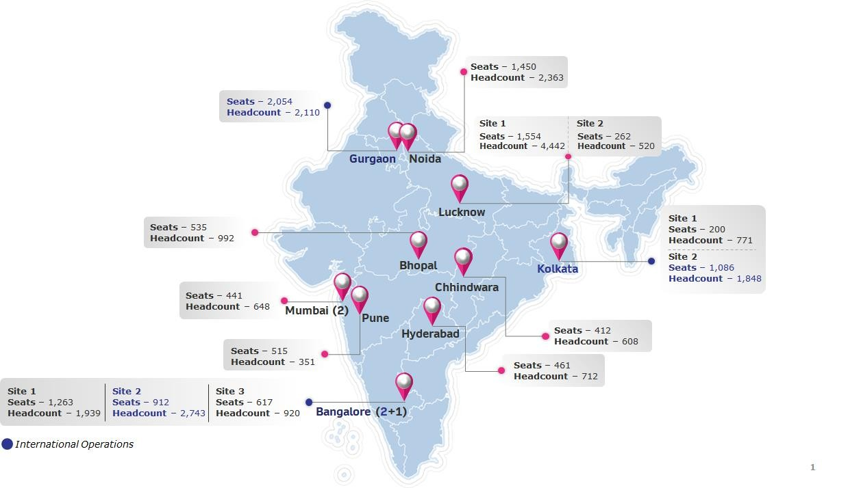


Our India footprint
20+
Years of Experience
20000+
20+
50+
14
Employees
Languages Supported
Number of Clients
Sites
Note: The locations have been marked approximately on the map
4

Slide 5
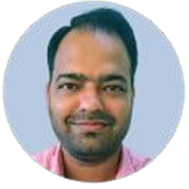
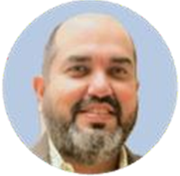
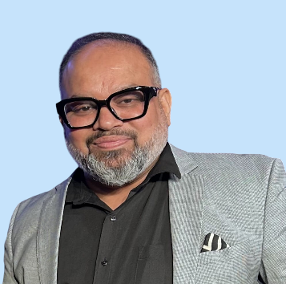
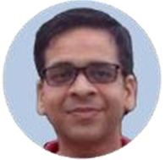
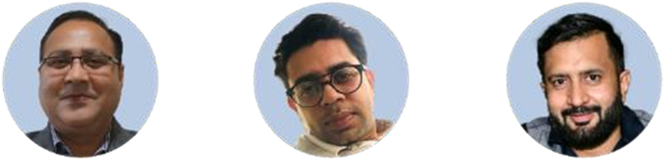
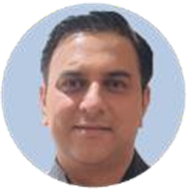
India Leadership Team
Deepak Singh – S.V.P
Ops. & India Head
Kannayya Tolwala –
S.V.P Operations
Ved Prakash –
India & SL H.R Head
Nikish Chandra –
VP MIS
Bhoop Singh Panwar –
V.P Administration
Sameer Grover –
V.P I.T Ops
Vineet Grover –
V.P Finance & Accounts
Pankaj Kakkar –
VP – T & Q

Slide 6
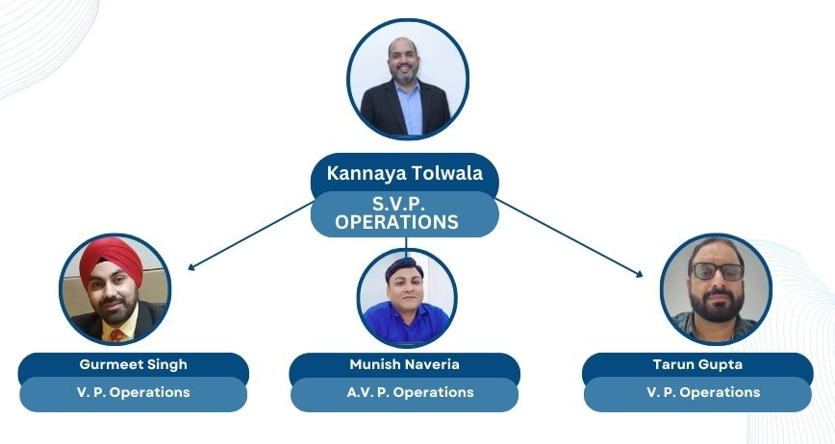
Business Head

Slide 7









Our diverse client portfolio (India)
Telecom & Wireless
Manufacturing & Automotive
BFS
Manufacturing & Automotive
Consumer Electronics
Healthcare
Food Tech
BFS

Slide 8
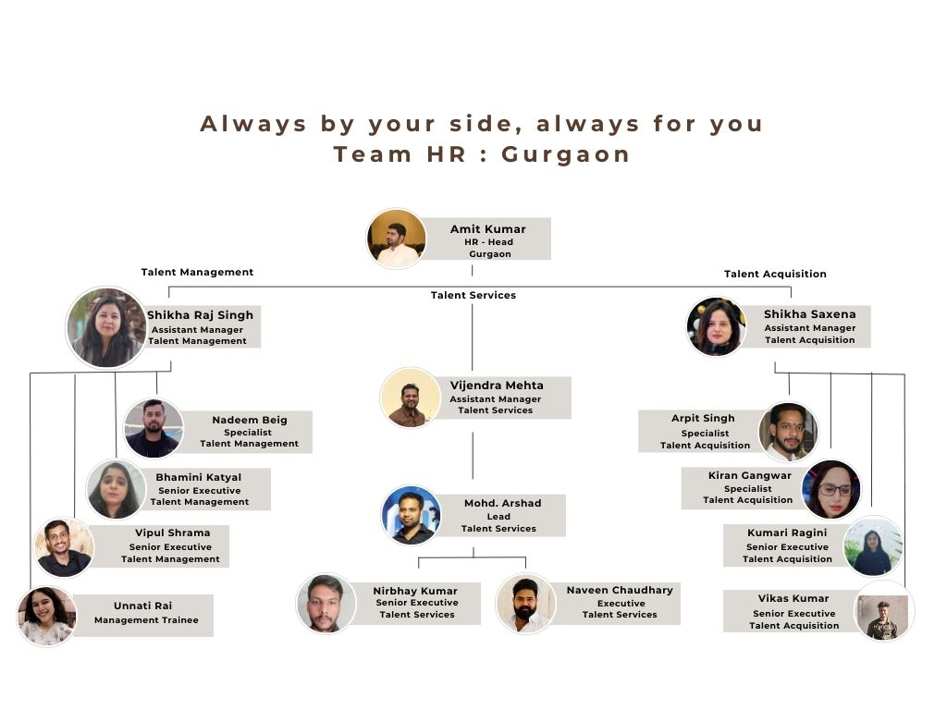
HR Team : Gurgaon

Slide 9
Thank You

